Slide 1
Economics 144 Economic Forecasting
Lecture 4
Modeling and Forecasting Trend
(Part II)
Dr. Randall R. Rojas

Slide 2
Today’s Class
Forecasting Challenges
Forecasting Environments
Model Selection
MSE
AIC
SIC
Trend Fitting via Periodic Functions
Trend Fitting via Holt-Winters Filtering
R Example

Slide 3
Forecasting Environments
The data sample is divided into two parts: usually 2/3 are used for estimation and 1/3 for prediction.
Def: Estimation Sample
This sample is used for estimating the model and respective parameters.
Def: Prediction Sample
This sample is used to assess the accuracy of the forecast.
Forecasting Methods:
Recursive
Rolling
Fixed

Slide 4
Forecasting Challenges
Lack of understanding of the phenomenon
Lack of statistical methods
High uncertainty
Lack of integration of skills(sensor fusion problems)

Slide 5
Recursive Scheme
One-step ahead
prediction at
time t
Estimation sample
(t observations)
Prediction sample
0
t
t+1
T
Estimation sample
(t+1 observations)
Prediction sample
0
t+1
t+2
T
t +1
.
.
.
.
.
.
.
.
Estimation sample
(t+j observations)
Prediction sample
t +j
0
t+j
t+j+1
T
Model parameters are update one observation at a time.
Notes:
Take the first t observations to run a regression
Use (1) to predict t+1
Let t = t+1
Repeat 1-3

Slide 6
Rolling Scheme
One-step ahead
prediction at
time
t
Estimation sample
(t observations)
Prediction sample
0
t
t+1
T
Estimation sample
(t observations)
Prediction sample
t +1
0
1
t+1
t+2
T
.
.
.
.
.
.
.
.
Estimation sample
(t observations)
Prediction sample
t+j
0
j
t+j
t+j+1
T
Model parameters are update using a fixed ‘window’ of observations.
Notes:
Suppose t =3 and the observation starts from 0
First estimation is 0,1,2
Second estimation is 1,2,3
And so on
Note: for finance data, you might want to use 3-month window to predict the data since the data is out in a quarterly manner

Slide 7
Fixed Scheme
One-step ahead
prediction at
time
t
Estimation sample
(t observations)
Prediction sample
0
t
t+1
T
Estimation sample
(t observations)
Update
Prediction sample
t+1
0
t
t+1
t+2
T
.
.
.
.
.
.
.
.
Estimation sample
t observations)
Update information set
Prediction sample
t+j
0
t
t+1
…………
t+j
t+j+1
T
Model parameters computed only one
Notes:
Fix the number of observations of the estimation sample
The estimates are used to predict the rest of the sample

Slide 8
Model Selection _{1 of 9}
Among the various model fits, how do we select the best one?
Need a measure of “best fit model”.
There are many metrics used for model selection such as e.g., MSE, AIC, SIC, Mallows CP, etc.
Depending on the Forecast problem on hand, certain metrics will be better suited than others for choosing an optimal model.

Slide 9
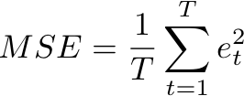


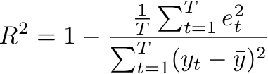
Model Selection _{3 of 9}
Mean Squared Error (MSE):
where and
The model with the smallest MSE is also the model with the smallest sum of squared residuals (maximizes R²).
Total sum of squares

Slide 10
Model Selection _{4 of 9}
As the number of parameters increases, the MSE performance deteriorates (overfitting)!
The out-of-sample forecast will not necessarily improve. However, it will improve the model’s fit on the historical data.
MSE is a biased estimator of the out-of-sample 1-step-ahead prediction error variance.
→The variance increases as the number of variables increases.
Need to include a penalty for including more degrees of freedom (variables)!

Slide 11

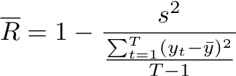
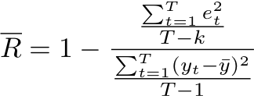
Model Selection _{5 of 9}
MSE (adjusted for df):
where k is the number of degrees of freedom (df) used in model fitting.
Adjusted R²:

Slide 12


Model Selection ₆ _{of 9}
Since:
Penalty Factor
Notes:
When k approaches T, s^2 approaches infinity. When n-k>50 the model is going to look fine

Slide 13


Model Selection _{7 of 9}
Two popular model selection metrics are:
Akaike Information Criterion
Schwarz Information Criterion
Note: SIC is more commonly known as the Bayesian Information Criterion (BIC).
Notes:
AIC has an exponential penalty whereas SIC has a polynomial penalty

Slide 14
Model Selection _{8 of 9}
Consistency: A model selection criterion is consistent if
(a) when the data-generating process (DGP) is among the models considered, the probability of selecting the true DGP approaches 1 as the sample size increases.
(b) when the DGP is not among the models considered, the probability of selecting the best approximation to the true DGP, approaches 1 as the sample size increases.
MSE: inconsistent
AIC: biased towards overparameterized models
SIC: consistent
Asymptotic Efficiency: Rate of the model selection process
AIC: asymptotically efficient
SIC: not asymptotically efficient
Notes:
DGP = economic engine
AE = as the sample size increases, there is an increase in accuracy of the parameters of the model relative to the true unobserved parameters

Slide 15
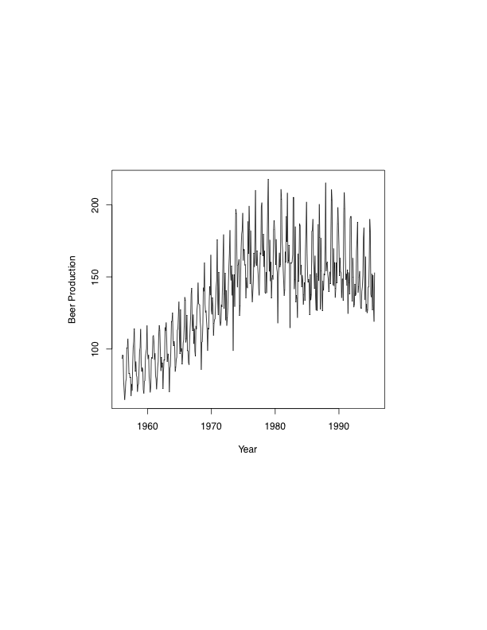
Example: Modeling and Forecasting Trend ₁ _{of 10}
Monthly Beer Production in Australia from Jan 1956 – Aug 1995
http://www.statoek.wiso.uni-goettingen.de/veranstaltungen/zeitreihen/sommer03/ts_r_intro.pdf

Slide 16
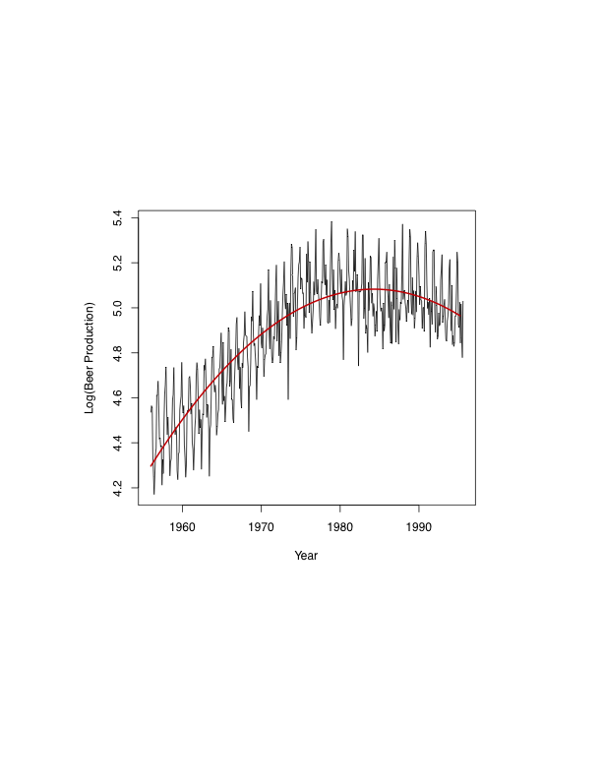
Example: Modeling and Forecasting Trend ₂ _{of 10}
Model 1:
(Quadratic)
Notes:
Log-to deal with the volatility
Quadratic-to deal with the shape

Slide 17
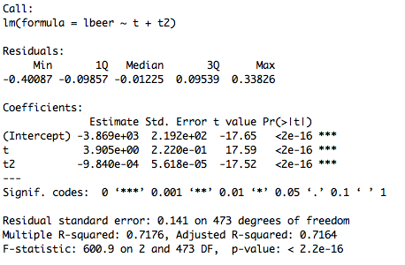
Example: Modeling and Forecasting Trend ₃ _{of 10}
Model 1 (Quadratic): Summary

Slide 18
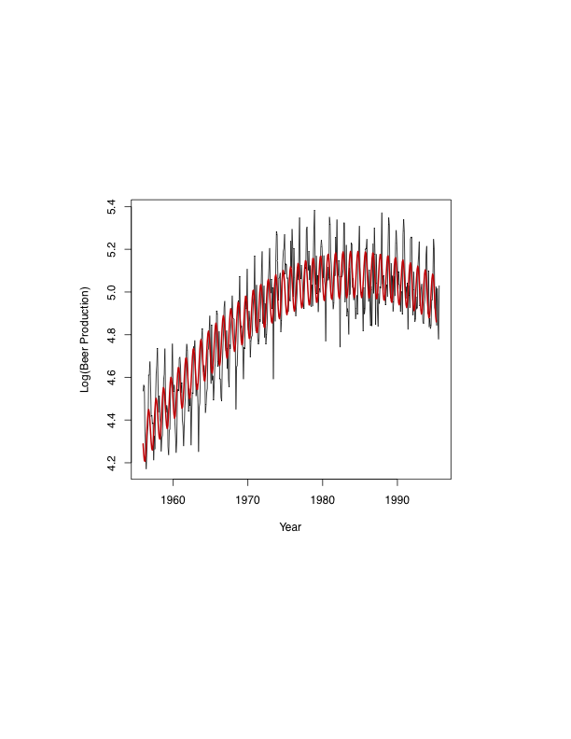
Example: Modeling and Forecasting Trend ₄ _{of 10}
Model 2:
(Quadratic + Periodic)
Add a periodic term.
Notes:
Periodic-to deal with the seasonal component of the graph

Slide 19
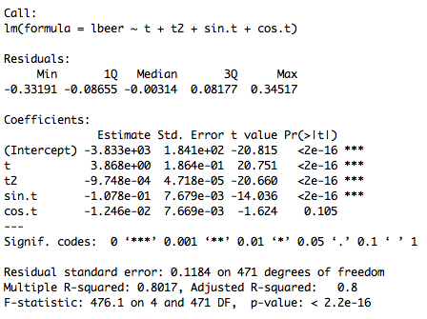
Example: Modeling and Forecasting Trend ₅ _{of 10}
Model 2 (Quadratic + Periodic): Summary

Slide 20
Example: Modeling and Forecasting Trend ₆ _{of 10}
Model 1 vs. Model 2
AIC (m1, m2) | df | AIC
Model 1 | 4 | -509.3847
Model 2 | 6 | -673.7203
Model 2 is better.
BIC (m1, m2) | df | BIC
Model 1 | 4 | -492.7230
Model 2 | 6 | -648.7278
Model 2 is better.
The smaller the value returned from AIC and BIC, the better the model.

Slide 21
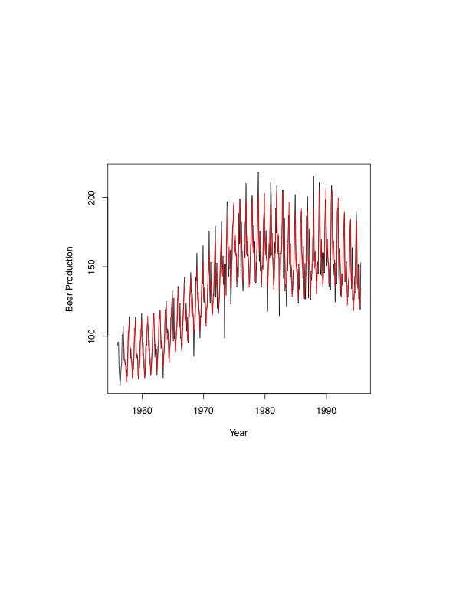
Example: Modeling and Forecasting Trend ₇ _{of 10}
Holt-Winters Filter: Considerably better model!
Notes:
This captures the trend, seasonality and amplitude of the graph

Slide 22
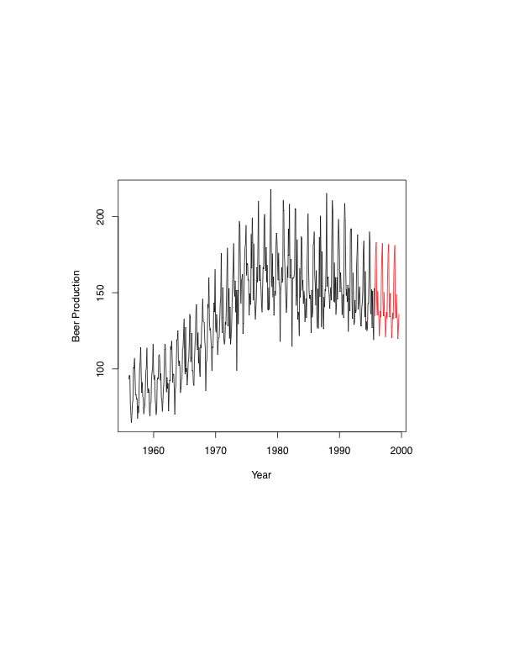
Example: Modeling and Forecasting Trend ₈ _{of 10}
Holt-Winters Prediction/Forecast for next 4 years
Forecast

Slide 23
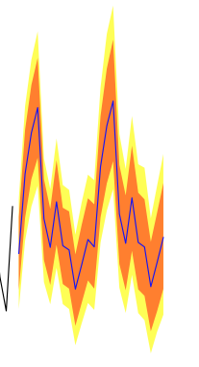
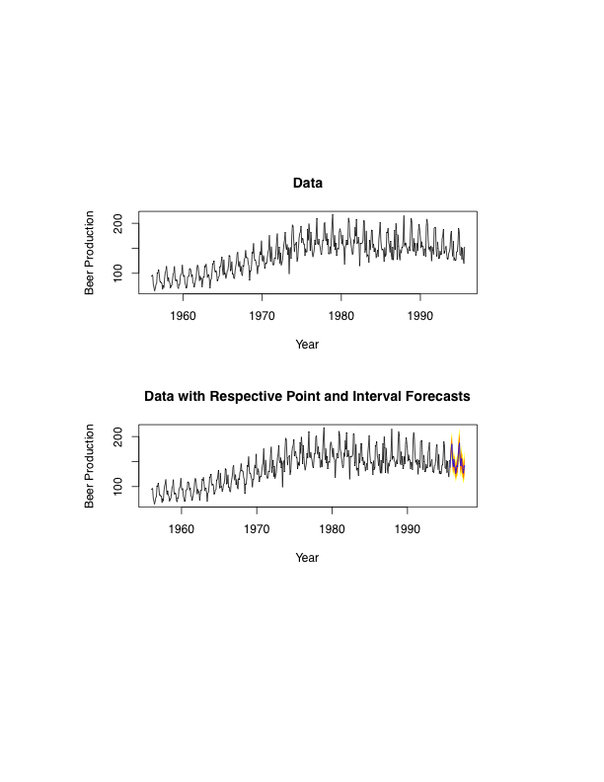
Example: Modeling and Forecasting Trend ₉ _{of 10}
Holt-Winters Point and Interval Forecast for next 4 years
Interval (95%)
Interval (80%)
Point forecast

Slide 24
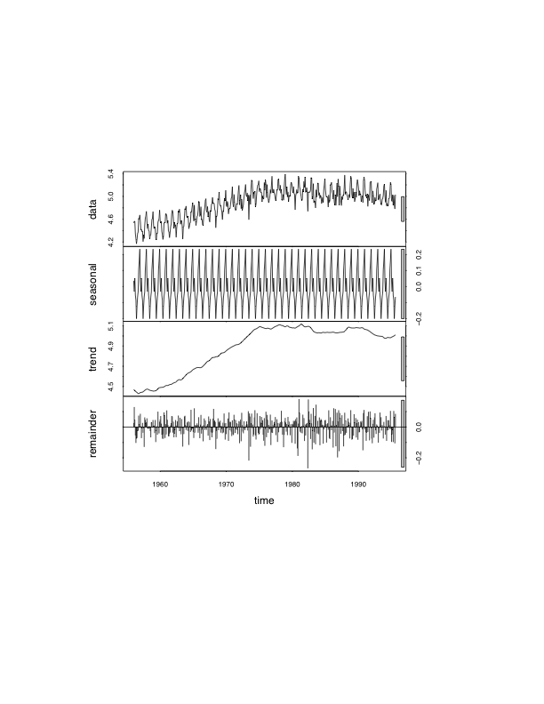
Example: Modeling and Forecasting Trend ₁₀ _{of 10}
Trend + Seasonal Components Decoupled

Slide 25
For Next Class
Readings about today’s class:
Chapter 4ª, 5^{b}
Review Exercises / Problems:
Chapter 5^{b}: 8, 9
Readings for next class:
Chapter 6^{b}: Modeling and Forecasting Seasonality

